Slide 1
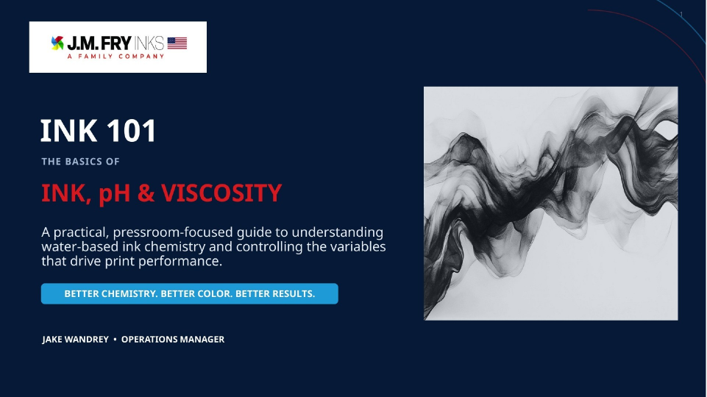
NAME
•
POSITION

Slide 2

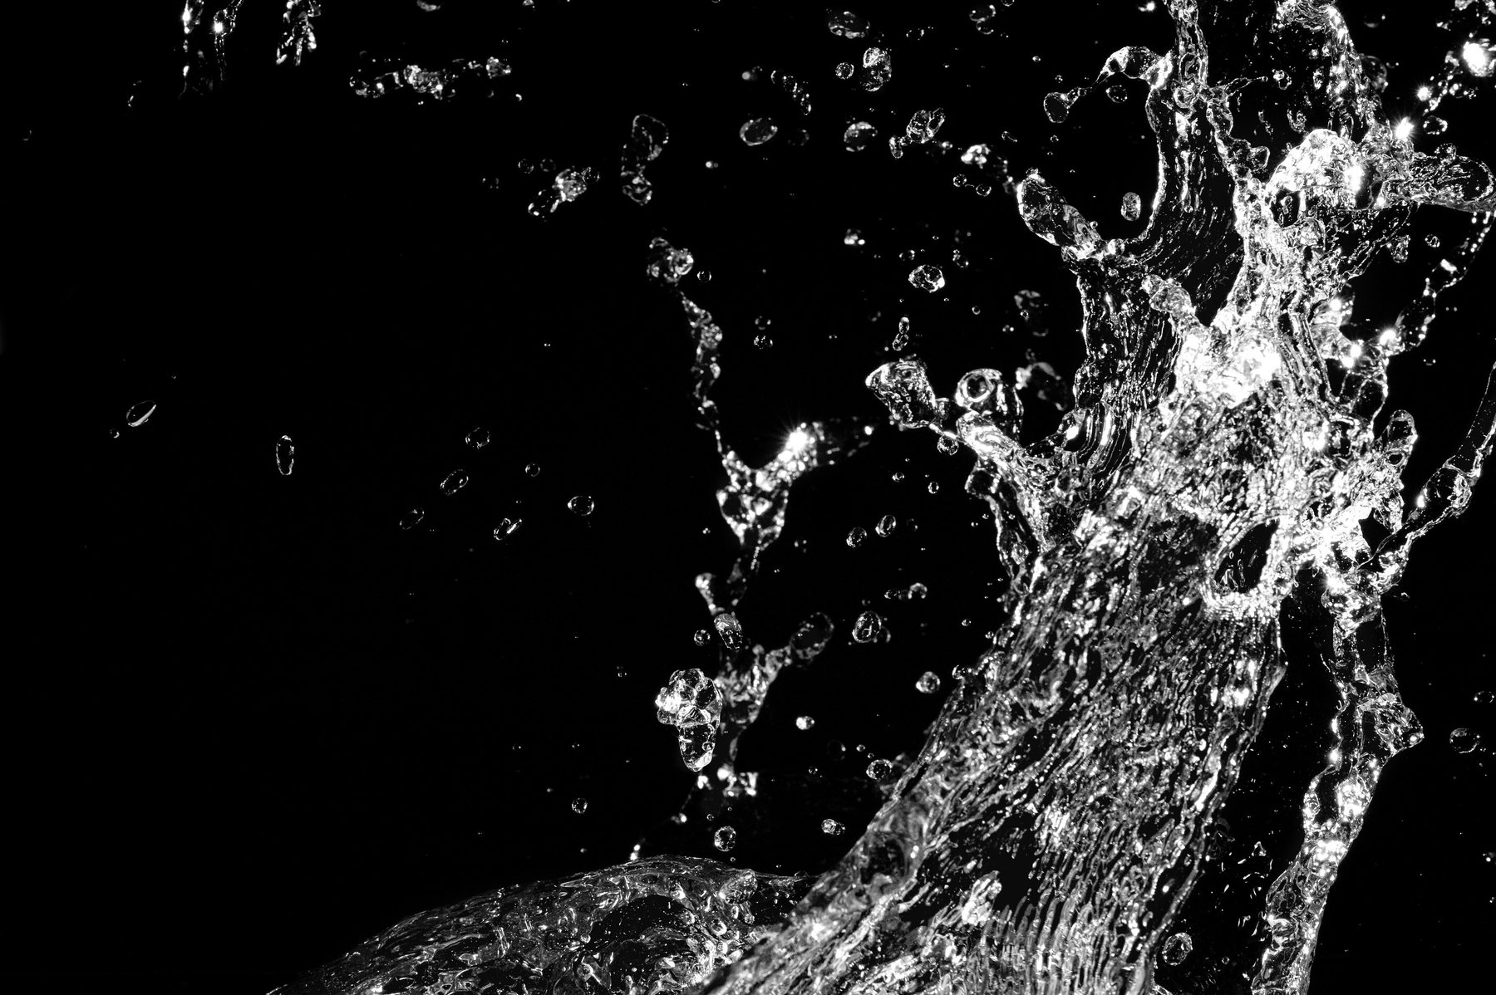
INK CHEMISTRY
What are water-based inks?
A stable water-borne system where solids, resins, surfactants and additives work together.
WATER-BASED INK
A stable dispersion in water of very small solid particles in a resinous vehicle, supported by surfactants and other performance additives.
WATER + RESIN + PIGMENT + ADDITIVES = CONTROLLED PRINT PERFORMANCE

Slide 3
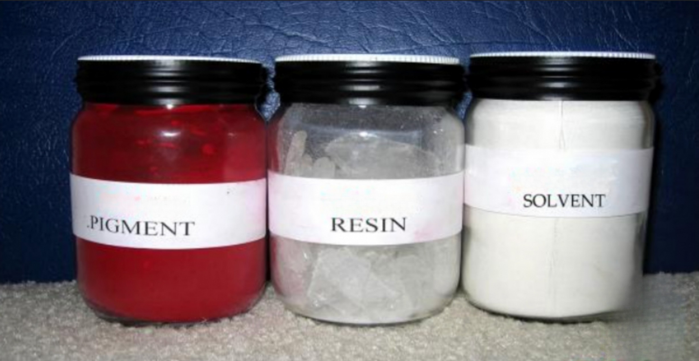
INK CHEMISTRY
What is ink made of?
Every ingredient has a role. The performance comes from how those parts work together.
RESIN / VEHICLE
PIGMENT
Creates the system and drives adhesion, resistance and printability.
The colorant. Grade and shade influence strength, appearance and cost.
ADDITIVES
SOLVENTS / VOLATILES
Fine-tune rub, transfer, foam control, wetting and other performance.
Water is the primary solvent; alcohol can help accelerate drying.
EVERY COMPONENT HAS A JOB. BALANCE THEM FOR CONSISTENT PRINT.

Slide 4
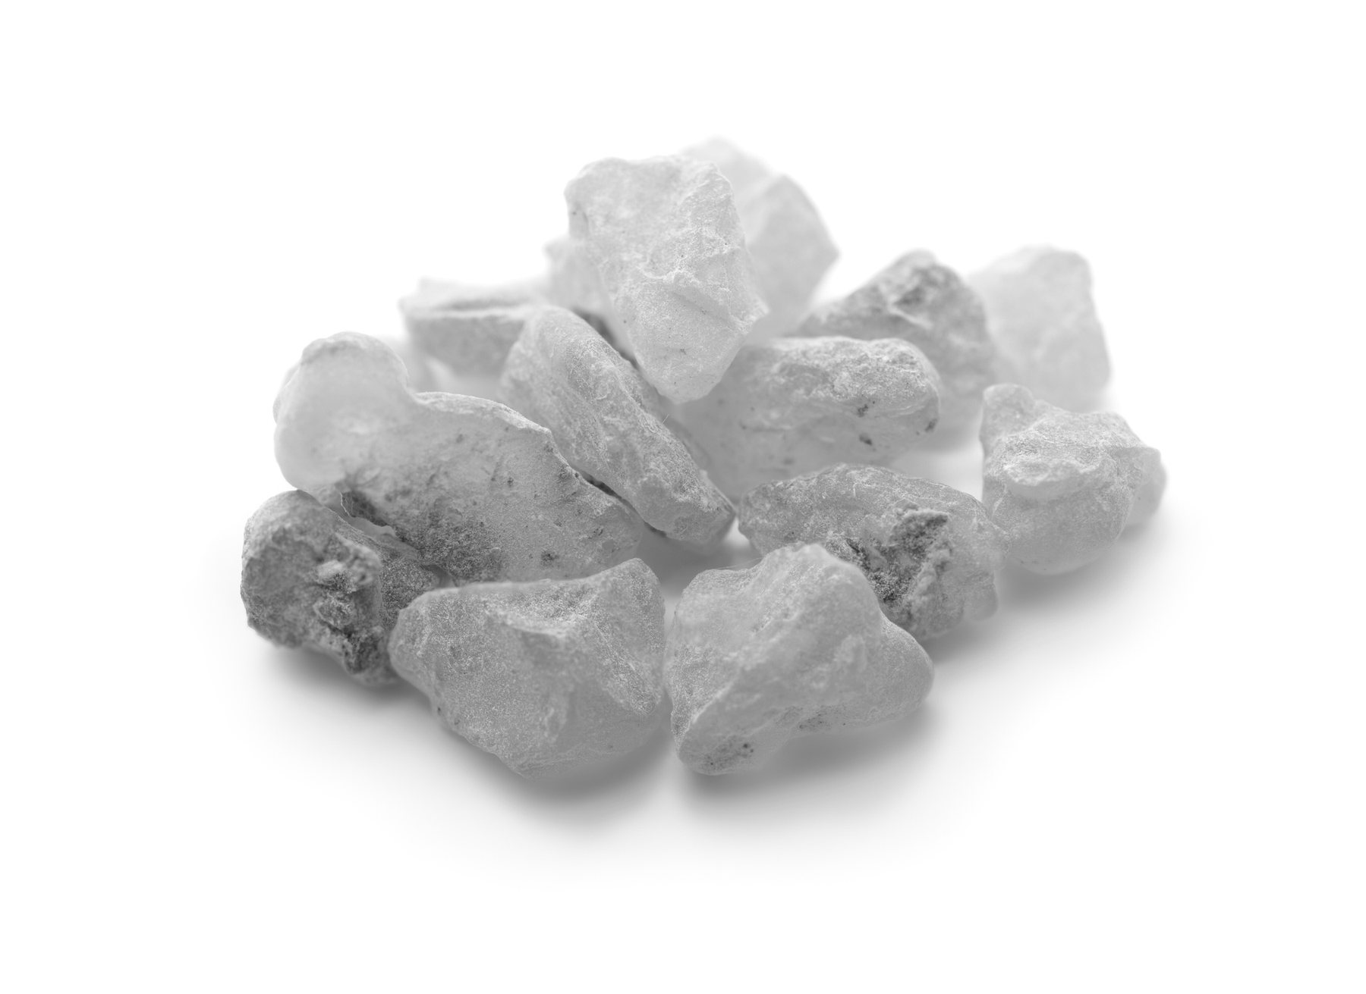
INK CHEMISTRY
Resin sets the foundation
The vehicle system dictates the primary properties of a printing ink.
RESIN / VEHICLE / EXTENDER
The system dictates the primary properties of a printing ink:
• Product resistance
• Adhesion
• Printability
• Ink transfer from system → anilox → plate → board
THE VEHICLE CARRIES THE COLOR — AND SETS THE RULES FOR PERFORMANCE.

Slide 5
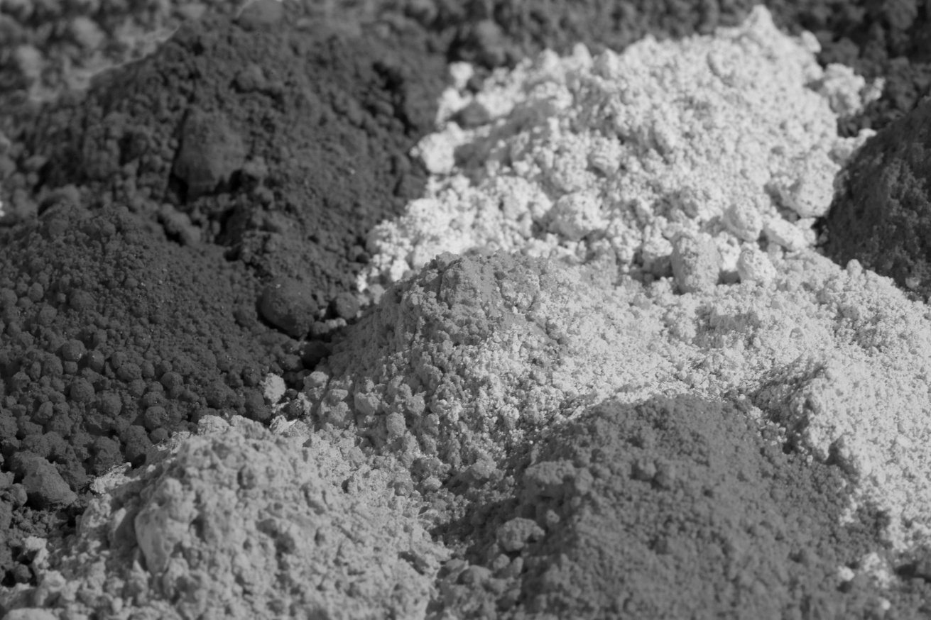
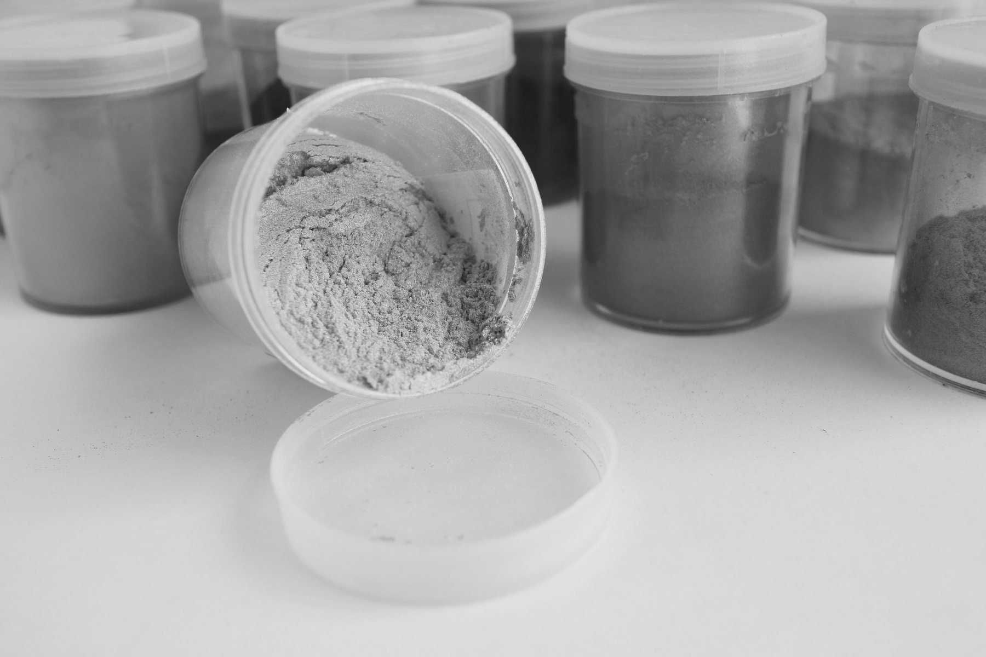
INK CHEMISTRY
Pigment defines the color
Pigment may be dry powder or pre-dispersed. It is often the most expensive raw-material portion of an ink.
WHAT YOU NEED TO KNOW
• Many different grades and shades are available.
• Pigment choice changes strength, shade and durability.
• Performance demands drive raw-material cost.
GENERAL RULE:
The more you want the pigment to do, the more expensive it — and the ink — will be.
PIGMENT DRIVES COLOR. PERFORMANCE REQUIREMENTS DRIVE COST.

Slide 6
INK CHEMISTRY
Additives fine-tune the system
Waxes, transfer aids, defoamer, surfactants, silicone and specialty performance aids enhance the ink system.
COMMON ADDITIVE FAMILIES
WHAT THEY CAN IMPROVE
• Rub resistance
• Printability
• Adhesion
• Foam control
• Wetting and transfer
MORE IS NOT BETTER — use only what the system needs.
• Waxes
• Transfer aids
• Defoamer
• Surfactants
• Silicone and specialty performance aids
USE ADDITIVES WITH PURPOSE — NOT BY HABIT.

Slide 7

INK CHEMISTRY
Solvents & volatiles
In water-based ink, water is the primary solvent. Alcohol can be used to accelerate drying speed.
60%
40%
WATER / AMINES
Provide solubility and re-solubility.
SOLIDS
Pigment, polymer and/or filler.
Alcohol may be used as a drying-speed modifier.
CONTROL VOLATILES. CONTROL FLOW, DRYING AND RESOLUBILITY.

Slide 8
INK CHEMISTRY
Typical water-based ink or coating
A practical way to think about the system: roughly 60% water/amines and 40% solids.
PIGMENT
POLYMER / RESIN
FILLER
40%
SOLIDS
Colorant
Film formation
Performance / cost
60%
WATER / AMINES
SOLIDS = combinations of pigment, polymer and/or filler.
KNOW WHAT IS IN THE MIX — THEN CONTROL WHAT CHANGES ON PRESS.

Slide 9
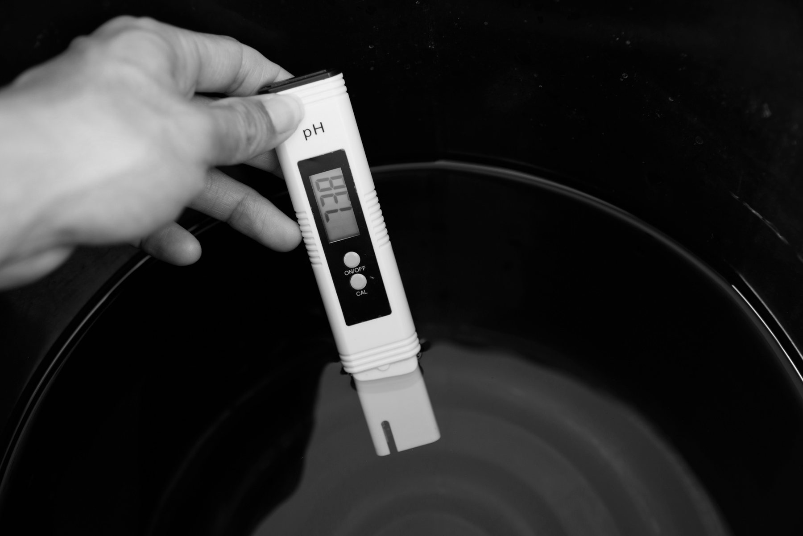
pH CONTROL
UNDERSTANDING
pH
THE pH SCALE
pH is a chemistry-control tool — not just a number.
TOO LOW
0 ACIDIC
7 NEUTRAL
14 ALKALINE
Fast drying • instability • color drift
8.5 – 9.5
ON TARGET
FLEXO INKS
Stable chemistry • repeatable performance
TOO HIGH
Slow drying • soft film • odor concerns
GET THE pH RIGHT. GET THE PERFORMANCE RIGHT.

Slide 10
PH CONTROL
How critical is pH control?
pH drift can create visible ink failure before the operator realizes chemistry has changed.
COLOR
TRANSFER
Unstable color / burnout
Harder to rewet and transfer
CLEANUP
VISCOSITY
Plate & anilox cleanup gets harder
Viscosity can drift with pH
CHEMISTRY DRIFT SHOWS UP AS PRINT DRIFT.
MEASURE EARLY. CORRECT SMALL CHANGES BEFORE THEY BECOME PRESS PROBLEMS.

Slide 11
PH CONTROL
What pushes pH off target?
Pressroom conditions can quietly destabilize ink chemistry during a run.
1
2
3
4
HEAT + LOW HUMIDITY
DOCTOR BLADE SHEAR
OVER-AGITATION
UNCOVERED INK KITS
Heat and dry air accelerate water and amine loss.
Friction and mechanical energy add heat to the system.
Excessive mixing can accelerate chemistry changes.
Open systems lose volatile components faster.
CONTROL THE ENVIRONMENT AROUND THE INK — NOT JUST THE INK ITSELF.

Slide 12
PH CONTROL
Low pH creates fast trouble
When pH drops below the control range, stability falls and the system can dry too fast.
1
2
3
Dries too fast
Less stable
Difficult to rewet
LOW pH
< 8.8
on anilox, plates or linerboard
on press
on plate
FAST DRYING
LESS STABILITY
HARDER REWET
4
5
6
Unstable color
Harder cleanup
Viscosity rises
shade can move
resin can stick
resin can "kick out"
LOW pH = LESS CONTROL, MORE STOPS, MORE CLEANUP.

Slide 13
PH CONTROL
High pH slows the system down
Too much alkalinity can create slow drying, soft film and odor-related problems.
HIGH pH
> 9.6
Slower drying
Softer film
Color burnout
ink stays open longer
reduced film strength
appearance can flatten
SLOW DRYING
SOFTER FILM
ODOR RISK
Viscosity decreases
Odor problems
Upper-end risk
flow can become too loose
excess amine / alkalinity
avoid running at the edge
HIGH pH TRADES DRYING SPEED AND FILM STRENGTH FOR EXCESS ALKALINITY.

Slide 14
PH CONTROL
Correct pH keeps the press moving
Balanced chemistry supports re-solubility, easier cleanup, stable viscosity and stable color.
CORRECT pH
GOOD RESOLUBILITY
FEWER WASH STOPS
8.8 – 9.6
on plates & roller
more uptime
EASY CLEANUP
STABLE VISCOSITY
less labor
repeatable transfer
TARGET THE MIDDLE — NOT THE EDGES.
STABLE COLOR
more consistent results
STABLE pH → STABLE VISCOSITY → STABLE COLOR.

Slide 15
PH CONTROL
Take care of pH. Save time and money.
Small chemistry habits compound into meaningful pressroom savings.
1
2
3
4
CLEANUP GETS EASIER
SHELF INK STAYS USABLE
RESTORE AT BOTH ENDS
SAVE TIME + MONEY
Plate and anilox cleanup is much easier.
Ink on the shelf doesn’t come back as mud.
Restore pH at the end of the run as well as the beginning.
Every avoided stop and cleanup adds up.
GOOD pH CONTROL IS PROCESS CONTROL — AND PROCESS CONTROL PAYS.

Slide 16
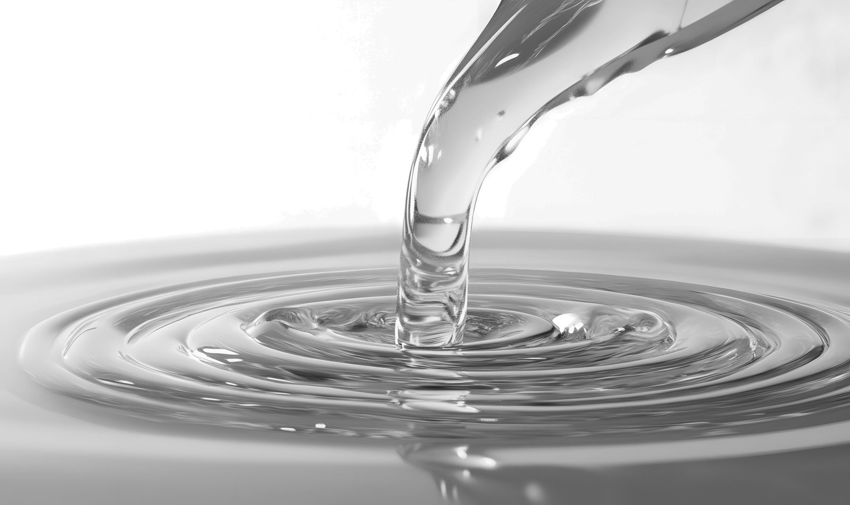
VISCOSITY
Viscosity is resistance to flow
The higher the viscosity, the less easily ink flows — and an ink’s pH influences its viscosity.
FLOW
More resistance to flow
HIGHER VISCOSITY
A measure of a liquid’s ability to resist flow.
Running viscosity affects how much ink is transferred to the stock.
Balanced flow + transfer
TARGET VISCOSITY
Less resistance to flow
LOWER VISCOSITY
FLOW CHANGES TRANSFER. TRANSFER CHANGES PRINT.

Slide 17
VISCOSITY
High vs. low viscosity
Running viscosity changes ink transfer, drying and print strength.
HIGH VISCOSITY
LOW VISCOSITY
• Excess ink transfer
• Tracking
• Smudging
• Slow drying
• Weaker print
• Dries too fast
• Foaming
• Poor coverage
TARGET VISCOSITY GIVES YOU CONTROLLED INK TRANSFER, DRYING AND COVERAGE.

Slide 18
VISCOSITY
Viscosity changes the color you see
Ink transfer changes with viscosity — even when the formula itself does not.
LOW VISCOSITY
STANDARD VISCOSITY
HIGH VISCOSITY
Less ink transfer
Balanced ink transfer
More ink transfer
WEAKER / LIGHTER
TARGET COLOR
DARKER / HEAVIER
Viscosity changes transfer → transfer changes apparent color strength.
Viscosity changes transfer → transfer changes apparent color strength.
Viscosity changes transfer → transfer changes apparent color strength.
SAME INK. DIFFERENT VISCOSITY. DIFFERENT COLOR RESULT.

Slide 19
PROCESS CONTROL
Build a repeatable control routine
Document checks. Restore chemistry. Repeat at a consistent cadence.
1
2
3
4
BEFORE JOB
EVERY 30 MIN
END OF RUN
DOCUMENT
Check / restore pH and viscosity before starting a new job.
Check pH and viscosity throughout the run.
Restore pH at the end of the run.
Record the checks so trends become visible.
CONSISTENCY COMES FROM A ROUTINE YOU CAN REPEAT — AND VERIFY.
CHECK IT. RECORD IT. RESTORE IT. REPEAT IT.

Slide 20
PROCESS CONTROL
Don’t let your ink enter the danger zone
Keep pH away from both the lower and higher ends of the acceptable operating range.
WORKING CONTROL RANGE
LOW DANGER
8.8 — 9.6
HIGH DANGER
✓
RUN IN THE MIDDLE OF THE RANGE
Avoid operating near either edge. The closer you get to the limits, the less margin you have for normal pressroom drift.
PROTECT THE MIDDLE. PROTECT THE PROCESS.

Slide 21

NAME
TITLE | J.M. Fry Inks
✉
EMAIL
☎
PHONE

